Slide 1
CSE 534
Final Project
Deept Tripathi(113070705), Vishal Singh(114708875), Harsha Vardhan(114394620)

Slide 2
Problem and Its importance
Developed a protocol on top of UDP to attain features of TCP.
Importance:
We have seen a renewed interest among the entreprises on leveraging flexibility of UDP.
Google has come with QUIC which uses UDP as its transport layer protocol.
HTTP/3 a major upcoming version of HTTP run on QUIC which is published as RFC9000.
We thought it would be interesting to look into the problem of adding reliability to UDP and understand the challenges in this domain.

Slide 3
Environment Setup
Created simple network topology with 4 host over Mininet.
In this, one of the host acts like Server and others acts like Clients.
Objective is to transfer the files from the host 1 to host 2.
This is tediously done on xterms on the hosts
Switch
-delay :: 5ms
-bandwidth :: 10MB(doesn’t affect since we are limited by the ethernet nics of the hosts and switch)
-loss :: varies 1 - 10
h1
h4
h2
h3

Slide 4
Algorithm
Our focus is mainly on achieving reliability and experiment the performance of our algorithms. The difference in our approach is the fact that we are frequently send ACKs/NACKs to the sender to update the next expected sequence number of the receiver
For receiver, we mainly focus on feedBack time and the buffer size from the
For sender our focus in on increasing and decreasing the congestion window
Notable features of our algorithms
Flow Control - Achieved using buffer overflow feedback from receiver
every feedbacks contains info where the buffer is overflowed.
Reliability - Achieved using ACK, NACK and Retransmissions
Configurations: Congestion window sizes, feedback time for NACK, Buffer sizes

Slide 5
Algorithms
1 - ''On Receiving a ACK, the sliding window moves to the sequence number received in the ACK”. Like GO_BACK_N
There were way to many retransmissions
3- ''On Receiving a NACK, the sender focuses to send only the NACK packet and continues with the sliding window protocol once the packet is received. Congestion window size is constant here(initial congestion window)”
Retransmissions reduced considerably
2- ''In addition to 3 , The sliding window updates immediately after reliably sending the NACK sequenceNo
One retransmission saved, doesn’t help much

Slide 6
Algorithms
Algorithm 1
Algorithm 2
1:CW
1:CW
ACK :N
NACK : N
N:CW
N
N
ACK : N2
N
N2: CW

Slide 7
Findings(Sender)
Retransmissions as well as Total time of transfer is considerably less for scenarios 2 and 3 as compared to 1. This is due to the fact that focus is more on packet lost.
This is helpful in the conditions when only 1 or 2 packets in the sliding window is lost. So instead of flooding the network with whole window, the sender only sends the NACKed packet

Slide 8
Findings(Receiver)
The feedback time should be set properly,
if too small, the network as well as the sender are flooded
If too large, the receiver is not able to preemptively set the window
Buffer
Larger buffer sizes help
But not considerably enough.

Slide 9
Buffer Large:: feedback time (0.1) vs (0.2)
As we can see from the graph that when feedback time (0.2), the total time taken is very large . Moreover in this case our algorithms performs similar because the feedback time is too large. Also we tested with feedback (0.01) and the timer was very slow
(0.01) too small
(0.1) just right
(0.2) too large
Our speculation is that it is important for the feedback frequency to be greater than the RTT(15ms). If the feedback frequency is less than the RTT, The receiver will only flood the network and the receiver.

Slide 10
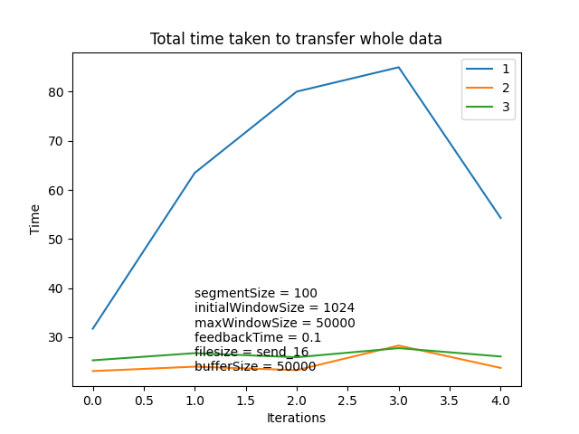
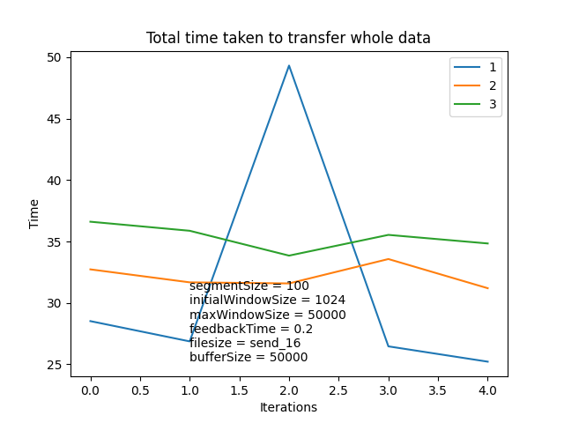
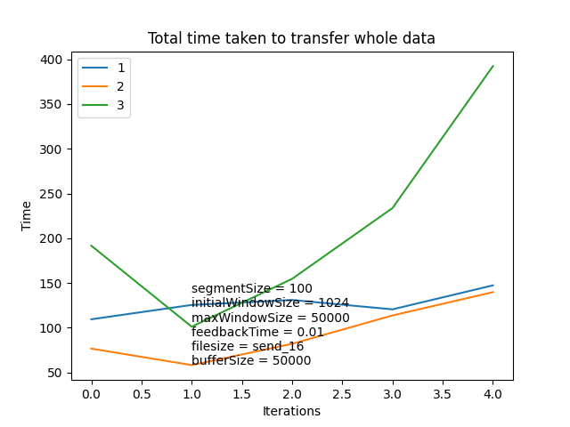
Buffer Large:: feedback time (0.1) vs (0.2) vs (0.01)

Slide 11
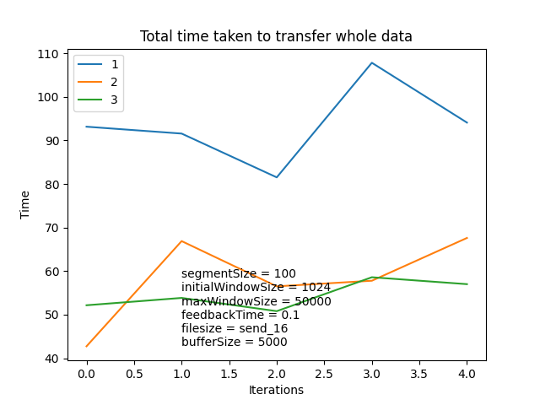
Feedback just right:: buffer small(5000) vs buffer large(50000)
It is clear in case of large buffer that the time taken is less for all algorithms
In both the cases, 2 and 3 outperforms, 1

Slide 12
Problems/ Limitations
Background process in mininet doesn’t behave same as it does in xterm
The socket programs are not as fast as the kernel programs . We were basically limited by the python programs in term of memory and speed
Lacks testing of congestion control
Could have got more insights from the logs in terms of dynamic buffer sizes and timeouts, and acknowledgement

Slide 13
